Slide 1

Flowchart

Slide 2
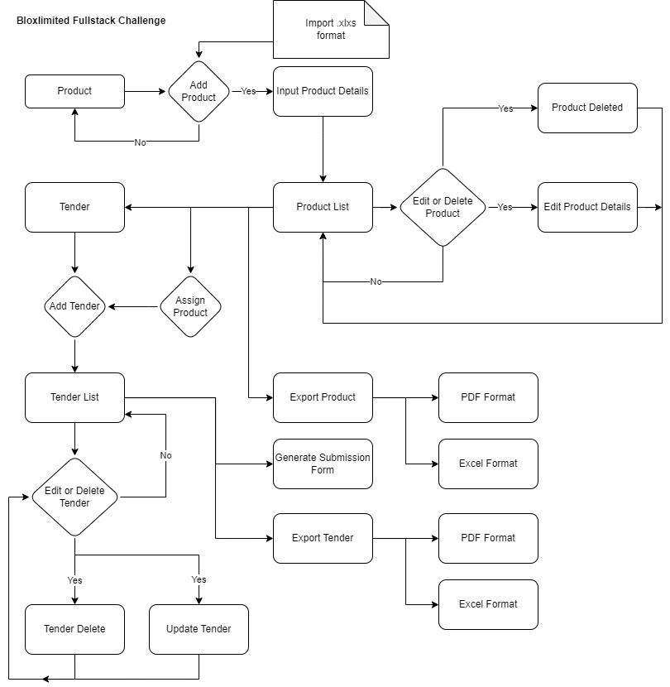

Slide 3
Dashboard References
Use this only for references, explore your imagination to create the most beautiful and user friendly dashboard!

Slide 4
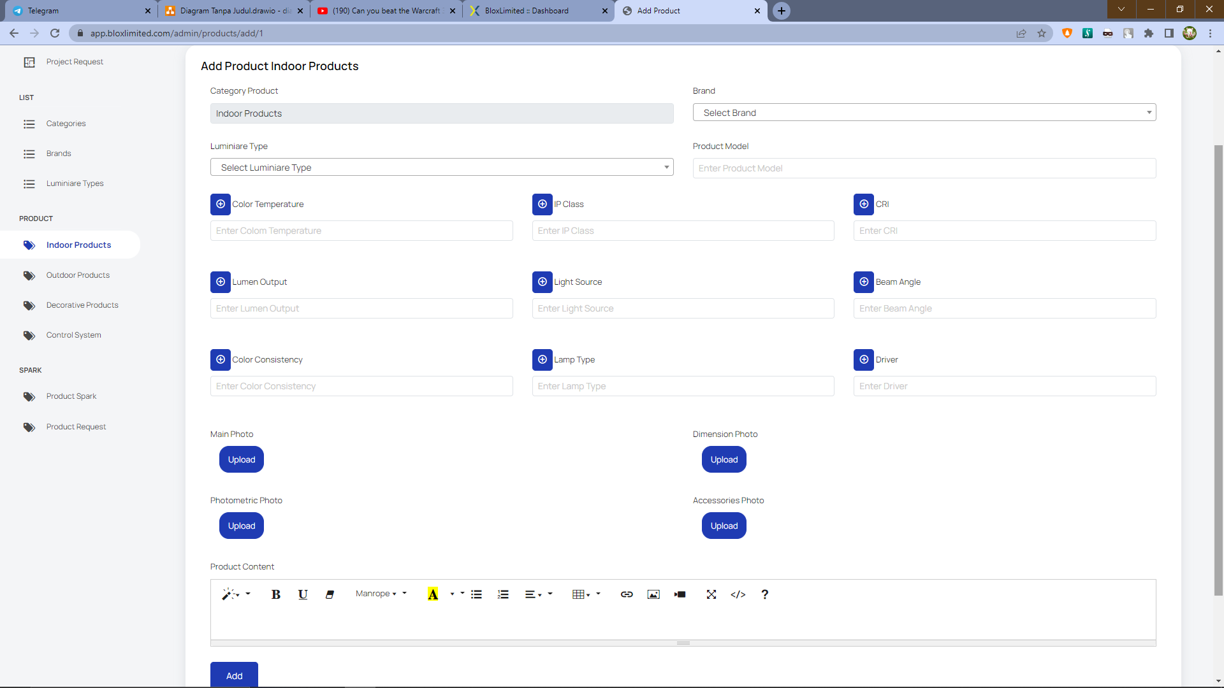

Slide 5
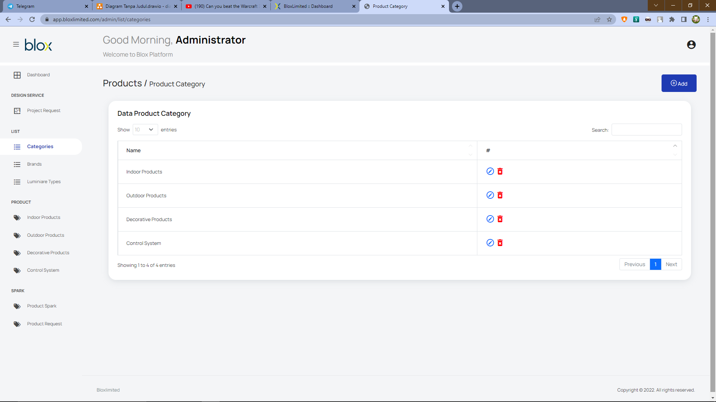

Slide 6
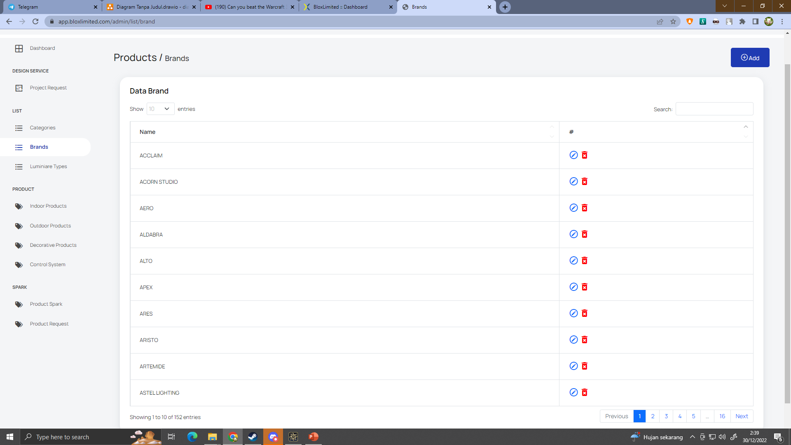

Slide 7
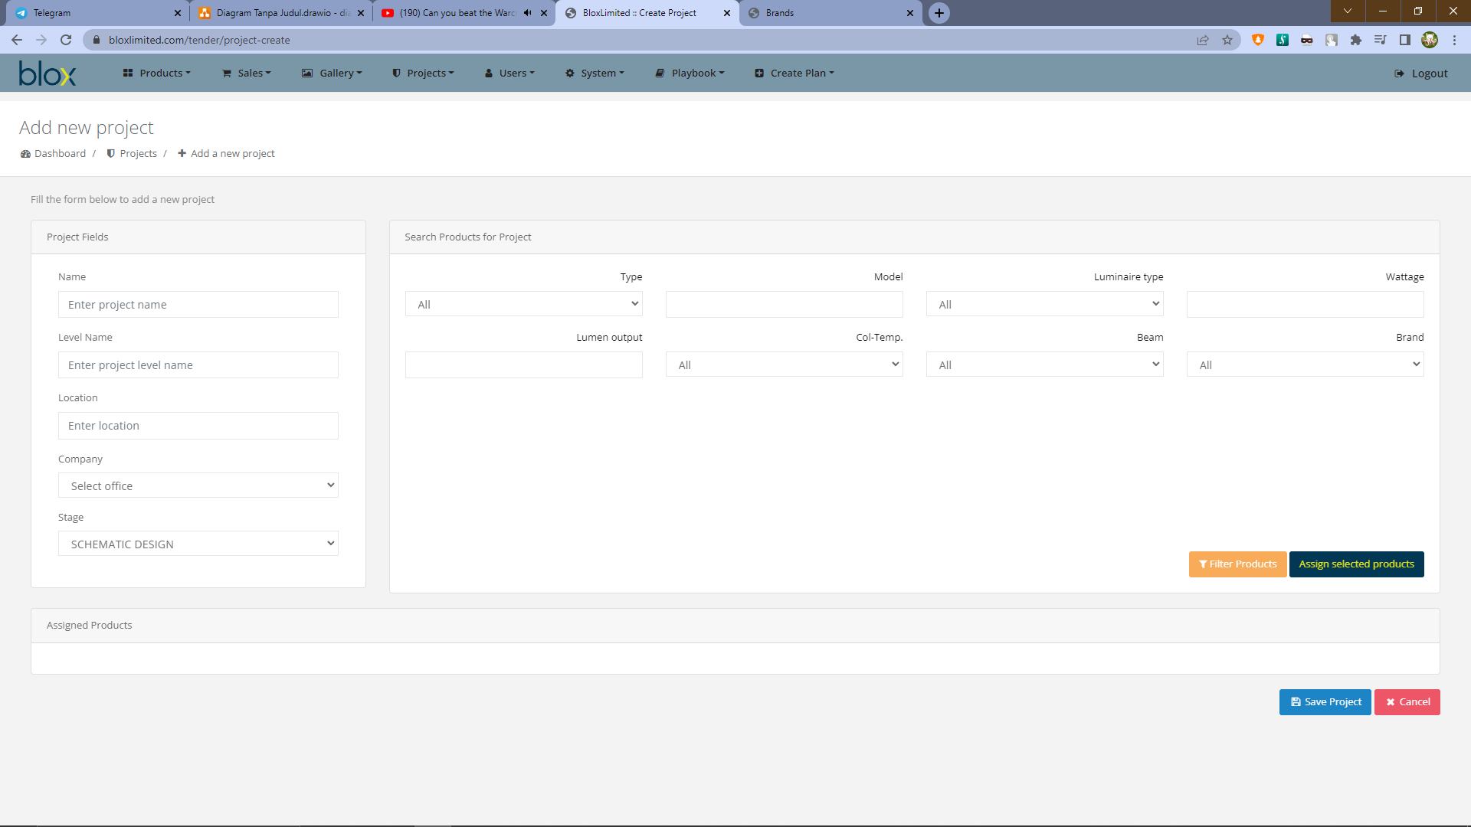

Slide 8
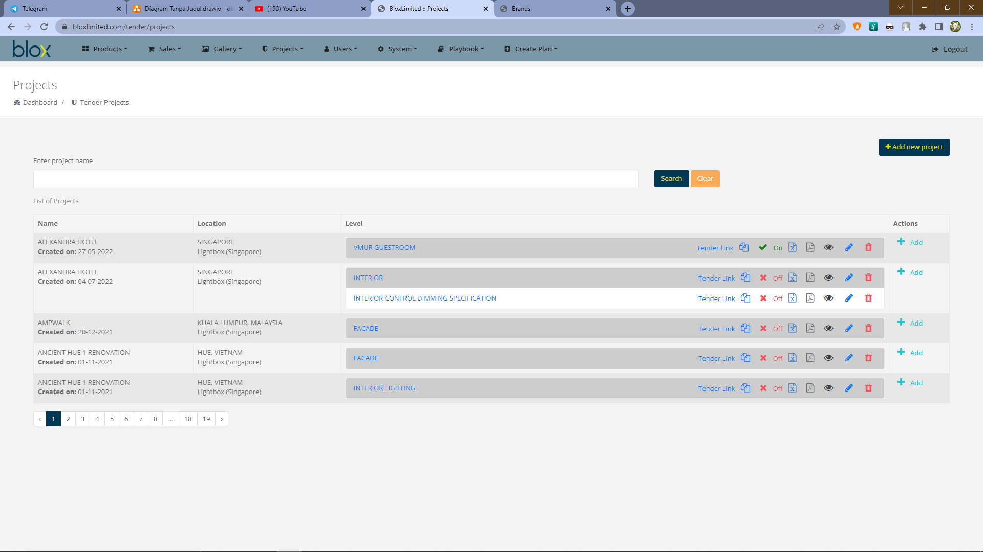

Slide 9
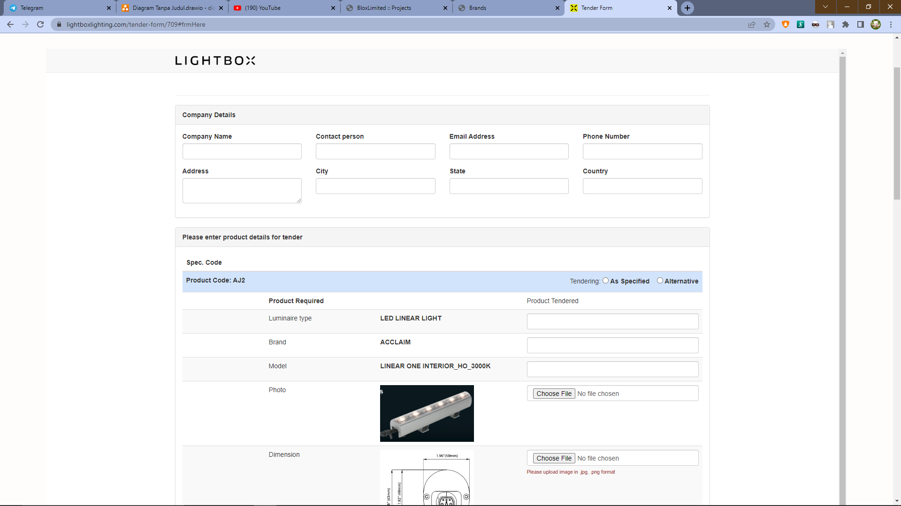
https://www.lightboxlighting.com/tender-form/709

Slide 10
Good LUCK!

